Slide 1

Internship Project

Slide 2

Student Name : Sai Swaran Reddy Rekulapally
Student ID : STU671c7768a08ee1729918824
College Name : GANDHI INSTITUTE OF TECHNOLOGY AND MANAGEMENT(GITAM) Hyderabad

Slide 3
CAPSTONE PROJECT SHOWCASE
Project Title : Energy Consumption Trend Analysis with Power BI
Abstract | Problem Statement | Project Overview | Proposed Solution | Technology Used | Modelling & Results | Conclusion | Q&A

Slide 4
Abstract
Purpose: The project involves developing an interactive Power BI dashboard to analyze energy consumption data for a business, focusing on trends, costs, and optimization opportunities for gas, electricity, and water.
Objective: It aims to visualize energy usage patterns across different locations (cities, buildings) and over time, identifying key metrics like total cost, units consumed, and rates.
Insights: The dashboard provides detailed comparisons of energy consumption by type, city, and building, highlighting patterns, seasonal variations, and outliers.
Optimization: Key findings enable businesses to identify high-consumption areas and implement strategies to optimize energy usage and reduce costs.
Advanced Features: It explores the potential of integrating machine learning for predictive analysis, anomaly detection, and natural language processing for conversational exploration of data.
Value Addition: The dashboard serves as a powerful tool for decision-makers to improve energy efficiency, drive cost savings, and enhance sustainability efforts.

Slide 5
Problem Statement
Develop an interactive Power BI dashboard to analyze energy consumption data for a business.
Provide actionable insights into:
Total costs
Unit consumption
Trends across energy types (gas, electricity, water).
Address challenges in visualizing and understanding energy usage patterns across:
Location
Energy types.
Enable businesses to identify inefficiencies, optimize energy utilization, and reduce costs effectively.

Slide 6
Project Overview
This project focuses on the development of an interactive Power BI dashboard to analyze and visualize energy consumption data for a business. The dashboard provides detailed insights into total energy costs, unit consumption, and trends across three key energy types: gas, electricity, and water.
The primary objective is to enable businesses to make data-driven decisions by identifying patterns, optimizing energy usage, and reducing operational costs. The dashboard serves as a comprehensive tool for analyzing energy consumption trends across multiple dimensions, including buildings, cities, and time periods.

Slide 7
Proposed Solution
Develop an interactive Power BI dashboard to visualize energy consumption data (gas, electricity, water).
Implement dynamic visualizations (line charts, bar graphs, pie charts) to analyze trends and costs over time.
Allow comparisons of energy data across different buildings, cities, and time periods.
Integrate key performance indicators (KPIs) to assess energy efficiency and cost optimization.
Apply advanced analytics, such as correlation analysis, to uncover hidden patterns and insights.
Support decision-making for cost reduction and sustainability through actionable data insights.

Slide 8
Technology Used
Power BI: A business intelligence platform by Microsoft used for data visualization, interactive dashboards, and reporting.
Excel: Used to handle and manipulate the energy consumption dataset before importing into Power BI.
Power Query: Utilized for data transformation and cleaning before visualizing in Power BI.

Slide 9
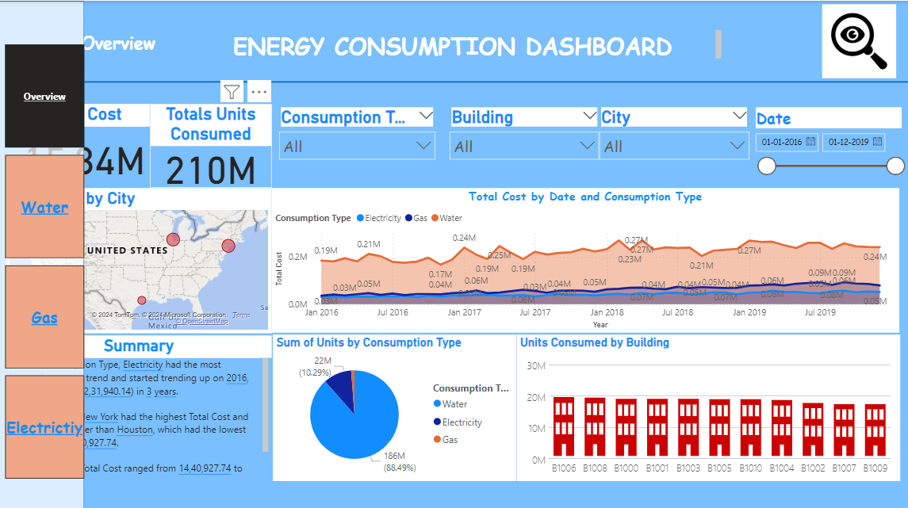
Modelling & Results Final Dashboard:

Slide 10
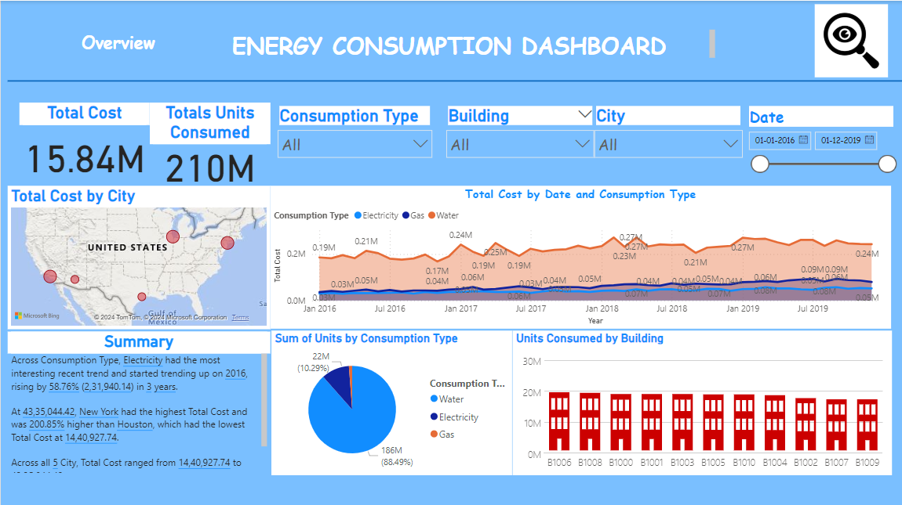
Overview Dashboard:

Slide 11
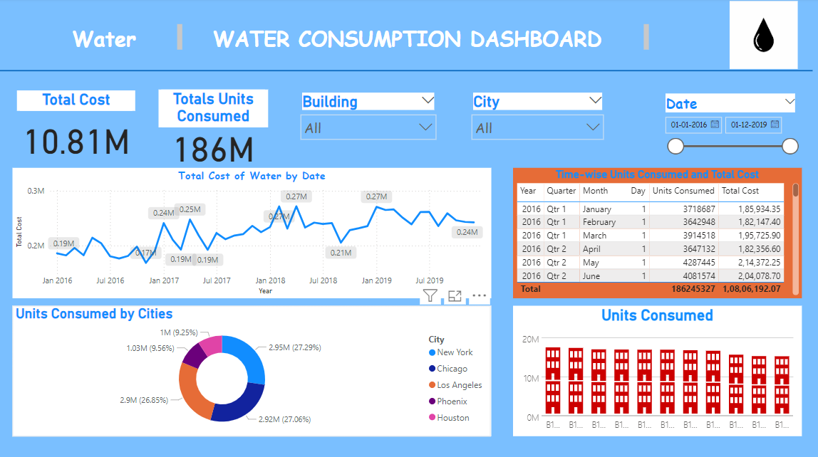
Water Dashboard:

Slide 12
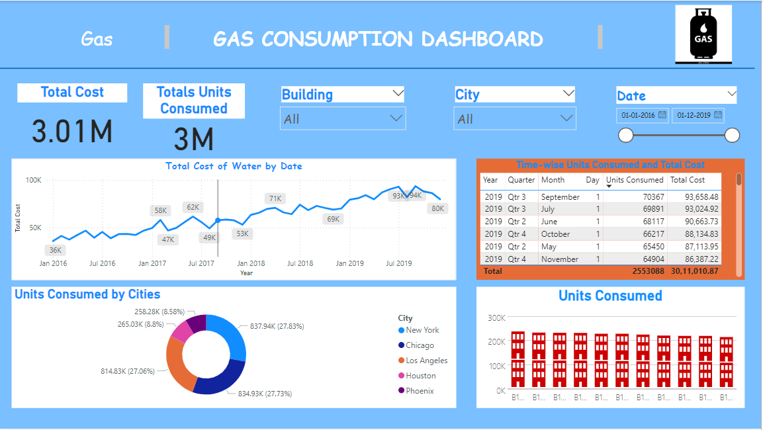
Gas Dashboard

Slide 13
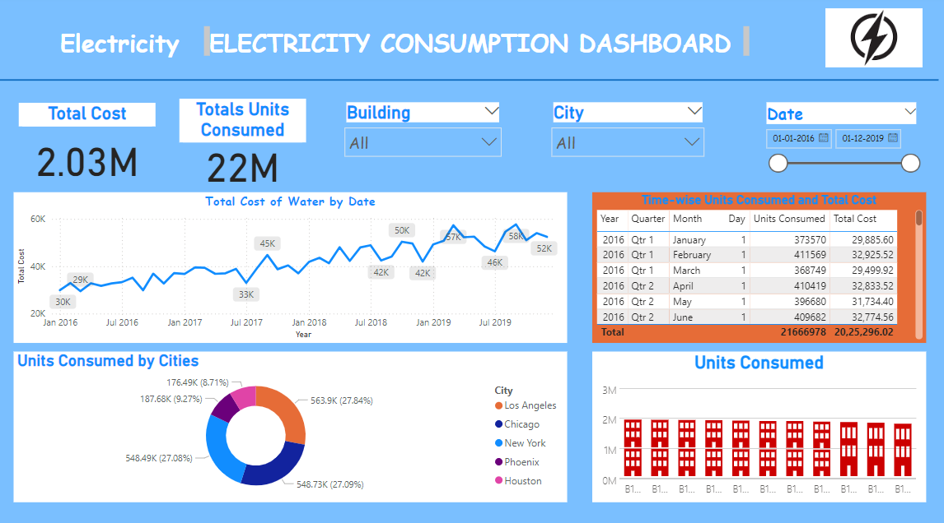
Electricity Dashboard

Slide 14
Conclusion
In conclusion, the Energy Consumption Dashboard provides a comprehensive and interactive tool to analyze energy consumption patterns across various energy types (gas, electricity, water) and key metrics like cost and units consumed. By leveraging Power BI, the dashboard facilitates the visualization of trends over time, comparisons across different locations and buildings, and the identification of areas for optimization. It empowers businesses to make data-driven decisions aimed at reducing costs, improving energy efficiency, and enhancing overall sustainability.
Insights Driven From Dashboard:

Slide 15
Thank You!
Notes:
Thank You !!

